Slide 1
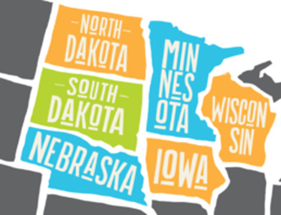
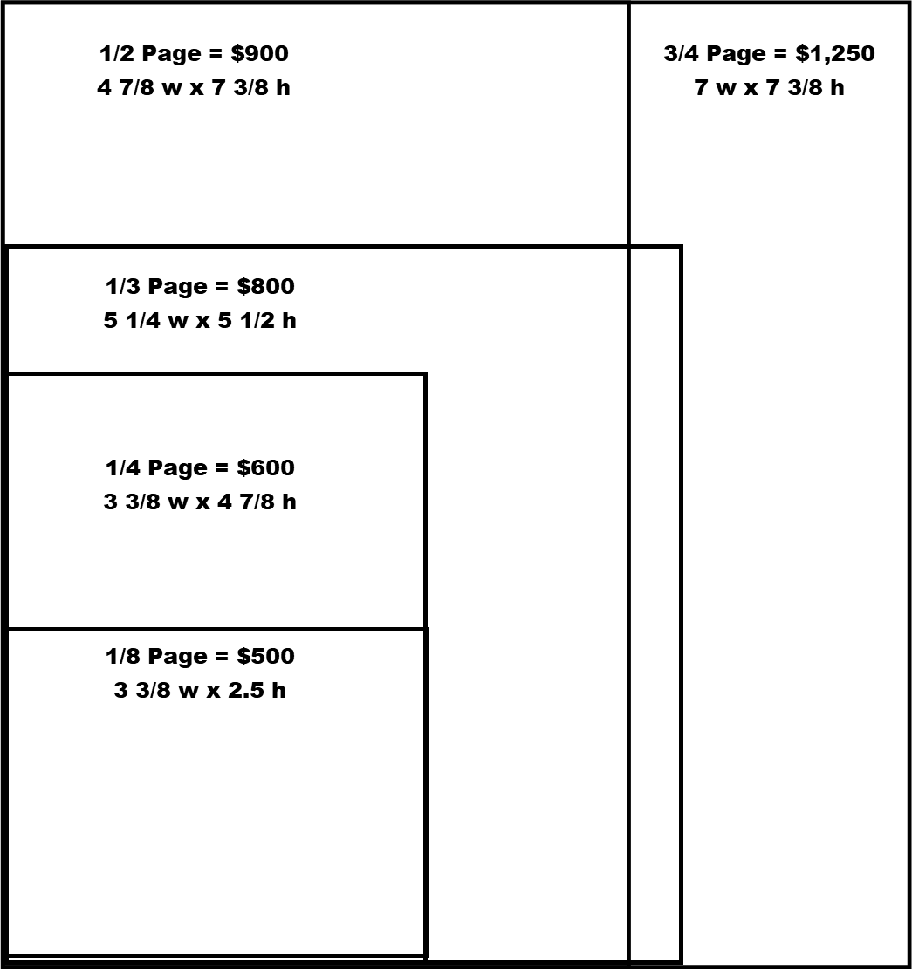
Book your ad space in the official 2023 Show Magazine today!
Don’t miss having your company advertisement in this 4-color, glossy
Expo Show Magazine! This indispensable guide to all things CPDE gets mailed to more than 4,000 producers in the dairy industry in Iowa, Minnesota, Nebraska, North
Dakota, South Dakota and western Wisconsin, approximately two weeks prior to the show.
Please return this form with your Exhibitor Registration to CPDE or email renee@centralplainsdairyexpo.com
Why CPDE?
w w w . c e n t r a l p l a i n s d a i r y . c o m
Size on page | Dimensions of Ad | Cost | We would like this option! (Check all that apply)
1/8 page | 3 3/8” w x 2.5” h | $500
1/4 page | 3 3/8” w x 4 7/8” h | $600
1/3 page | 5 1/4” w x 5 1/2” h | $800
1/2 page | 7 3/8” w x 4 7/8” h | $900
3/4 page | 7 3/8” w x 7” h | $1,250
1 full page | 7 3/8” w x 10” h | $1,550
2 page spread | 16 1/2” w x 11” h | $2,800
1/2 page back cover | 7 3/8” w x 4.625” h | $1,900
1 page, inside front | 7 3/8” w x 10” h | $1,900
1 page, page #3 | 7 3/8” w x 10” h | $1,900
1 page, inside back cover | 7 3/8” w x 10” h | $1,900
Exhibitor
Information
Star Sponsorships
Booth
Application
All ad artwork is due to renee@centralplainsdairyexpo.com by December 9, 2022.
Membership
Application
File types should be high resolution jpg or pdf file formats.
Exhibitor Insurance
Show Magazine
Ad rates are for full color or black and white.
Sponsorship
Information
Central Plains
Dairy Foundation
New Product Press Release
Does your company have a new or recent product or service you will be exhibiting or talking about at the Central Plains Dairy Expo? Submit a short press release on our website about it and we will put it in the Expo Show Magazine for free. You can also include a photo of your featured product. If you don’t have
a photo, send your logo. Go to https://www.centralplainsdairy.com/product-press-release-form/ to
submit your request by December 9, 2022.
#CPDE2023

Slide 2
SPONSORSHIPS
Welcome Reception Sponsorships, Tuesday, March 28, 2023, 5:00 PM
Dairy Industry Moover Sponsors $5,000
Includes playing a 2-3 minute video at the Welcome Reception, supplied by sponsor
Up to 2 reserved tables for the Welcome Reception if desired
Promotion opportunities include PowerPoint slide, Show Magazine recognition, website listing, EMOOs listing
Herd Leader Sponsors $3,000
Includes up to 2 reserved tables for the Welcome Reception if desired
Promotion opportunities include PowerPoint slide, Show Magazine recognition, website listing, EMOOs listing
Milk Master Sponsors $1,000
Includes 1 reserved table for the Welcome Reception, if desired
Promotion opportunities include PowerPoint slide, Show Magazine recognition, website listing, EMOOs listing
Prayer Breakfast Sponsorships, Wednesday, March 29, 2023, 6:15 AM – 8:30 AM We are very excited to continue this prayerful and inspirational piece as part of the CPDE. This year the Ag Prayer Breakfast will be held on Wednesday, March 29, 2023. As in the past, we would appreciate your support for this great event.
Here are a few highlights for 2023:
The Prayer Breakfast is free to all attendees.
Tables will have 10 seats and bleacher seating will be available.
Sponsors will have the option of reserving tables at the breakfast if they would like.
Attendees will enjoy a delicious breakfast with all the dairy fixings.
Doors open at 6:15 a.m., program beginning at 7:00 a.m.
Tim Lovelace will be speaking at this event. Tim’s passion for life is contagious and effectual.
All sponsors donating $500 or more will receive recognition at the event with signage on the stage at the Prayer Breakfast, in the program, in the Expo Show Magazine, in the Dairy Star and on a huge poster displayed during the whole two days of Expo.
In-kind sponsorships and donations
We are so grateful for all the dairy donations for our Expo! At CPDE 2022 attendees were graced with
all these dairy products for free!
More than 1,500 grilled cheese sandwiches
700 half pints of milk
300 various flavored yogurts
1,800 assorted ice cream novelties
84 gallons of ice cream
AND 700 pounds of cheese!
w w w . c e n t r a l p l a i n s d a i r y . c o m
Why CPDE?
Exhibitor
Information
Star Sponsorships
Booth
Application
Membership
Application
Exhibitor Insurance
Show Magazine
Some of these items are donated and some have to be purchased by the Expo. If your company has any in-kind dairy product you would like to donate please contact Renee at renee@ centralplainsdairyexpo.com. Additional ideas for the dairy bar may be (but are not limited to) cheese sticks, cheese curds, pretzels and cheese sauce, promotional plates, bowls, napkins, cups or
plasticware. We would be happy to have a conversation about how best to incorporate these or any
other items you have in mind.
Sponsorship
Information
Central Plains
Dairy Foundation
All sponsors will receive mention in the Expo Show Magazine, on the CPDE website and on-site at the event. Increase your business’s exposure by having your support and sponsorship recognized with any of these branding sponsorship opportunities.
First right of refusal will be given to sponsors that have actively sponsored the last Expo and
reserved their sponsorship by November 18, 2022.
#CPDE2023

Slide 3
SPONSORSHIPS
NEW FOR CPDE 2023!! ED (EDUCATION) SHED
The Expo Arena Ed Shed gives you another opportunity to increase your exposure and share your message! Exhibitors and sponsors may reserve 25 minutes during Expo Hall open hours. This is your time – outside your booth – to educate attendees and promote your products/services. (Please note that all booths must be staffed during Expo Hall hours.) A sound system, TV screen and HDMI cord will be available to support your presentation. Please bring any dongles that you may need for compatibility to HDMI.
w w w . c e n t r a l p l a i n s d a i r y . c o m
Why CPDE?
Ed Shed presentations appear in the online schedule and mobile app so attendees can add your session to their personal schedules. This is a great opportunity to demo a new product, pitch benefits of new services and gather prospective dairy attendees names. Promote your session by having a drawing or giving away coupon discounts.
Exhibitor
Information
Fee: $1,000 per 25-minute presentation. Receive 25% off when you reserve by December 9, 2022.
DIGITAL SPONSORHIP OPPORTUNITIES
Facebook and Instagram will be the social platforms used. Company profiles will be tagged in social
posts and company websites can be linked at the sponsor’s request.
Sponsors are responsible for providing all ads and digital assets in a camera-ready format.
Star Sponsorships
EMOOs NEWSLETTER | Cost | We Are Interested!
Banner Ad (600 x 150 pixels) | $200
Tile Ad (160 x 150 pixels) | $50
In Text Ad (450 x 350 pixels) | $100
Video Ad (2 minutes or less) | $100
SOCIAL MEDIA
Company Spotlight Post | $125/post
New Product Release Shout Out | $200/post
Expo Booth Preview | $150
Video Clip | $100
CPDE ONLINE MEMBERSHIP DIRECTORY ENHANCEMENTS
Company Logo | $150
PDF File (2 page limit) | $100
Additional PDF pages | $50/page
Video Clip (2 minutes or less) | $100
Booth
Application
Membership
Application
Exhibitor Insurance
Show Magazine
Sponsorship
Information
Sponsors desiring on-site branding are encouraged to use Fox Printing in Sioux Falls, S.D. They are the preferred vendor of the Denny Sanford Premier Center for all printing and event branding.
They can be reached at (605) 275-4700 or by emailing Krista Martinson krista@foxprintsd.com.
Central Plains
Dairy Foundation
*** No floor signs are allowed in any of the buildings. No unauthorized sign hanging is allowed outside of your booth square footage or the ceiling above your booth, unless purchased through the sponsorships.***
Public Service Announcement!
CPDE does not sell or release the Expo attendee list to anyone. If you receive an email solicitation telling you otherwise, it is a scam!
#CPDE2023

Slide 4
SPONSORSHIPS
Welcome Reception Sponsorships | Cost | We Are Interested!
Dairy Industry Moover | $5,000
Herd Leader | $3,000
Milk Master | $1,000
Tuesday night (3/28/23) reserved table for 10 | $350/table
On-site Branding Opportunities Pricing DOES NOT include production costs
Ed shed | $1,000
Registration computer/Ipad splash screens | $3,000
Premier Center
Outside banners | $500
Great wall 12’ x 9’ | $1,000
Steps to second level | $500
Exterior windows (16 available) | $300 each
Convention Center
Ballroom one doors (2 available) | $350 each
Exhibit hall one doors (6 doors available) | $350 each
Exhibit hall two doors (2 doors available) | $350 each
Entrance pillar wraps (2 available) | $350 each
Restroom audio | $700
Restroom mirror bottom border | $400
Hallway pillar wraps (10 available) | $300 each
Hanging banners above your booth | $500 each
Hanging banners in center hallway (8 available) | $300 each
Arena
Entrance pillars | $350 each
Between door posters | $300
Foyer ticket windows | $700
Hospitality area wall wrap 23’ x 14’ | $650
Second level glass panels | $150 each
Railing banners | $100 each
Restroom mirror bottom border | $400
On-site Branding Opportunities at Sheraton Sioux Falls & Convention Center
Hotel column wraps (11 available) | $450 each
Walkway windows to and from Arena 70” x 34” (15 available) | $450 each
Banners hanging off 2nd floor 3’ x 5’ | $450
Hotel Key card s(provided by sponsor) | $600
Additional Opportunities
Coffee station sponsor (4 available) | $600 each
Wine and cheese social sponsor (6 available) | $1,500 each
Welcome Reception appetizer sponsor (6 available) | $1,500 each
Pancake breakfast | $2,000
Mobile app banner ads (15 available) | $1,000 each
Push notification via mobile app (5 available) | $350 each
Wednesday morning Prayer Breakfast (3/29/23) sponsor | $500
Badge scanning/lead capture | TBD
w w w . c e n t r a l p l a i n s d a i r y . c o m
Why CPDE?
Exhibitor
Information
Star Sponsorships
Booth
Application
Membership
Application
Exhibitor Insurance
Show Magazine
Sponsorship
Information
Central Plains
Dairy Foundation
#CPDE2023

